Slide 1

Crime and Punishment in Britain
Ms Khanom
Session expectations
Silence during presentations
Make your own independent notes - do not just copy from the board, listen carefully.
Use the headings at the top of each slide to create sub-headings and organise your notes.
Listen carefully to the information
Write questions down and wait for the Q+A.

Slide 2
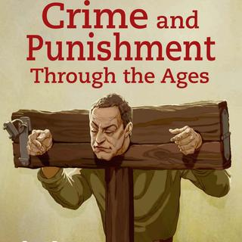
Crime and Punishment in Britain
Ms Khanom
Key topic 1: 1000-1500 Medieval England
Anglo Saxons
Norman Conquest
Later Middle Ages
Role of the Church
Key strands: Crime, Law enforcement/Policing, Punishment
Keywords: Social crime, Crimes against person, Crimes against authority, law enforcement, policing, corporal punishment, trial by ordeal.

Slide 3

Which factors led to change and continuity in Crime and Punishment in England?
Poverty and Wealth
Attitudes in Society
Institutions- Government
Institutions-Church
Individuals
Most important impact on C & P
Criminal Activity
Factors are things that influenced Crime and punishment.
They help cause change
They helped encourage continuity.
Methods used to enforce the law
Punishment
Science and technology
Travel
Towns
Important but not consistent through time

Slide 4
Crime: Anglo-Saxons
Anglo-Saxon society were based on close knit farming communities.
The most common crimes were crimes against person and property.
An example of crimes against property is petty theft.

Slide 5
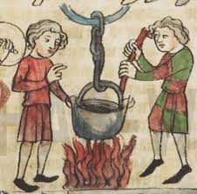
Law enforcement: Anglo-Saxons
Play me first!
There was no official police force therefore enforcement of law was the responsibility of the local community.
Methods used to police crime: Tithings and Hue and cry.
Trials is a form of enforcing the law and ensuring justice.
Methods used: Trial by Jury and Trials by ordeal.
Types of Trials by ordeal: Trial by cold water, Trial by hot water,
Trial by hot iron and Trial by blessed bread.
Factors that are influencing law enforcement:
Attitudes in society – Due to the small communities and people knew each other well. People thought it was their duty to look out for each other.
The Church: The Anglo-Saxons were deeply religious and believed that God could help judge crimes. When a jury could not reach a decision Trials by ordeal was used.
Play me second!

Slide 6
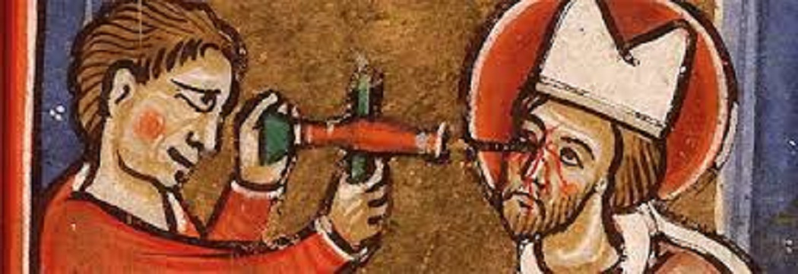
Punishment: Anglo-Saxons
Play me second!
Play me first!
Anglo-Saxons used the following methods of punishment: Fines, Capital punishment, Corporal punishment.
Fines: Wergild – compensation paid to the victims of crime or their families. It was also used to settle cases of physical injury. Different body parts had different prices. Loss of an eye = 50 shillings whereas a broken arm = 6 shillings.
Capital punishment – Executions was used if someone was guilty of treason against the King or Lord. This helped enforce loyalty.
Corporal punishment – Mutilation – reoffenders could lose a hand, an ear or even blinded.
How much was life worth in Anglo-Saxon England?
Prince | 1500 Shillings
Yeoman farmer | 100 Shillings
Serf (Peasant) | 40 Shillings

Slide 7


True or False and Q+A
Anglo-Saxon communities were based on the feudal system.
Social Crime is a crime committed in a society.
Law enforcement and policing means only a police force.
Tithings were made up of 14 men over the age of 10.
Wergild is a type of capital punishment.
Corporal punishments like mutilation took place during the Anglo Saxon era.

Slide 8

True or false? Q+A
Anglo-Saxon communities were based on the feudal system.
Social Crime is a crime committed in a society.
Law enforcement and policing means the way the law and order is marinated in a society.
Tithings were made up of 14 men over the age of 10.
Wergild is a type of capital punishment.
Corporal punishments like mutilation took place during the Anglo Saxon era.
Farming communities
Social crime is a crime which many people turn a blind eye to
Tithings were made up of 10 or more men aged over the age of 12
Wergild is a fine (fines are a type punishment).

Slide 9
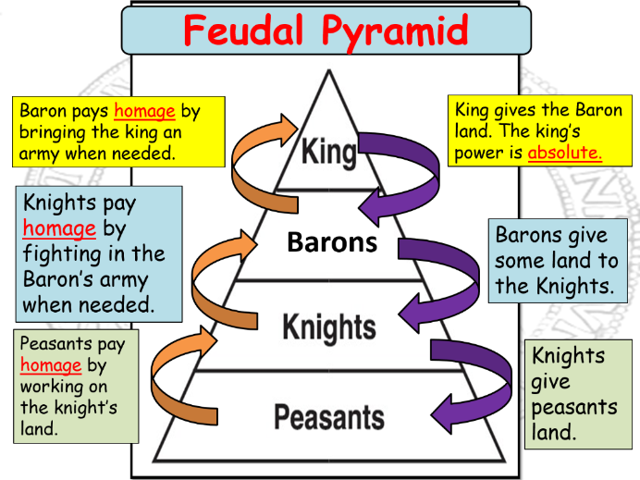
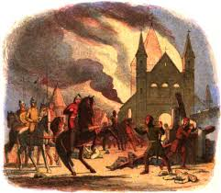
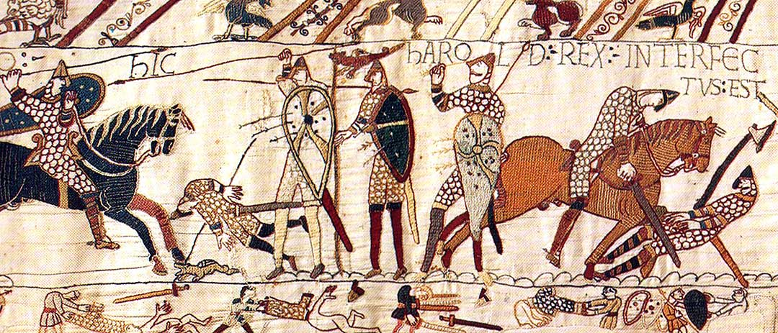
The Norman Conquest
Feudal System
In 1066 William of Normandy defeated King Harold Godwinson and became the new King of England.
Originally from France, Normandy, King William I now had the huge task of enforcing foreign rule over England.
He faced many rebellions and challenges therefore needed to secure his power and the safety of his Barons and Lords against the Anglo-Saxons.
Nobles
Serfs

Slide 10
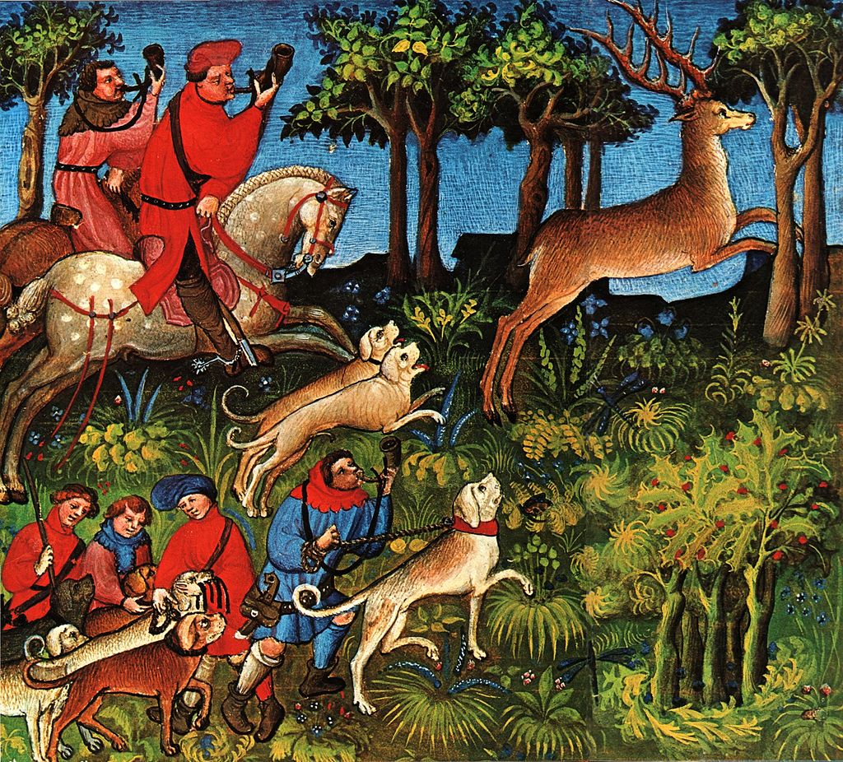
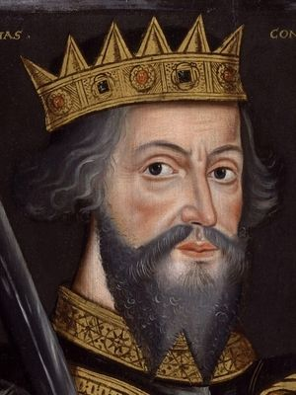
Crime: Norman England
Changes | Continuity
Murdrum Law: If a Norman was murdered all the people of the region (or hundred) has to join together an pay an expensive fine. Forest Laws: This protected Norman hunting lands and prevented ordinary people from hunting in the forest causing starvation for many as access to natural resources were cut off. Peasants used to have the right to graze animals, take firewood or catch rabbits. This was seen as a social crime: actions that were technically illegal but most people in society disapprove of and turn a blind eye. | The vast majority of Anglo-Saxon laws remained unchanged. Why?
Medieval chroniclers state that England was a safer and more law-abiding place after the Norman conquest, perhaps suggesting that there was less crime.
Factors that influence crime:
Government: King William wanted to be viewed as the rightful heir to the English throne. Therefore he realised that it was important to keep most of the laws of the previous Saxon Kings.

Slide 11
Law enforcement: Norman England
Changes | Continuity
Castles were built in every part of the kingdom. Peasant workers were made to build these and Norman lords would live in and control the local population under Norman law. The castles were designed to keep a watch on communities and look intimidating to remind those of Norman power. Foresters: These were Normans who were tasked to enforce the Forest laws. Trial by combat was introduced. The accused fought with the accuser until one was killed or unable to fight on. The loser was then hanged, as God had judged them to be guilty. Church courts were established. These were separate courts used or churchmen and tended to be more lenient. | Normans kept the local systems of tithings and hue and cry. Trial by ordeals continued.
Factors that influence law enforcement
Institutions government and church: The Normans were highly religious and believed God could help them judge crimes. They continued developed Trial by ordeal by introducing trial by combat and formalised the role of the church in law enforcement by establishing church courts.

Slide 12
Punishment: Norman England
Changes | Continuity
The Normans ended Wergild. Fines were no longer to be paid to the victim or the family. Instead all fines were to be paid to the King’s officials. This gave him increased revenue. Murdrum Fine: This was an example by which fines were now paid to the king. | Capital punishment was used for serious crimes and for reoffenders .
Factors that influence punishment
Government: Again we see William I does not change much, but he does ensure that the king is the one who receives fines showing his power and authority.

Slide 13
Anagrams and Q+A
Steerfros
Mailliw
Baittcorymalb
Furmminerud
Strouc hcruhc
Mornan
Foresters
William
Trial by Combat
Murdrum Fine
Church Courts
Norman

Slide 14
Later Middle Ages c1100-1500
During the later middle ages (c1100-1500) medieval kings took an even closer interest in crime, law enforcement/policing and punishments.
There was a growing belief that punishments including execution were the best way to deter criminals.
Parliament is in practice during this time – in the 13th century this meant a gathering of powerful individuals who met with the king to discuss and introduce new laws.
Medieval kings during this time that you must be familiar with are:
Henry II, Richard I and Edward III.

Slide 15
Crime: Later middle ages
Changes | Continuity
The Statute of labourers: After the Black Death killed about 1/3 of the population peasants began to demand higher wages due to the lack of labourers available. The ruling class, to protect their interests used the Statute of Labours to prevent higher wages. The law provided a minimum wage for workers and criminalised requests for higher pay. It also made it illegal to move to another area to look for better paid work. Heresy: Laws against heresy were introduced in 1382-1401 and 1414. But this crime becomes more serious in the Early Modern Era. | The ruling class during Norman’s rule also brought in laws to protect their interests as the expense of the poor – Forest laws.
Factors for change
Government: Parliament alongside the King created the laws against heresy and the statute of labourers. Here we see parliament growing in their influence for law-making.
Poverty and wealth: The Black Death created a shortage of workers therefore resulting in changes to poverty an wealth and the relationship between workers and the ruling class.

Slide 16
Law enforcement: Later middle ages
Changes | Continuity
Village constables were appointed annually to look out for crimes and lead the hue and cry if necessary. These were unpaid volunteers and well respected in the community. Coroners were royal officials and investigated unnatural deaths. (Richard I) Keepers of the “King’s Peace” – Knights were appointed by Richard I to police unruly areas in 1195. in 1327 Edward III extended this system to all areas, by 1362 they were known as Justice of Peace and met 4 times a year to carry out their magistrate duties and enforce the law. The sheriff was responsible in assembling the posse to hunt down criminals if the hue and cry failed. Trial by ordeals abolished 1215. Henry II and the Assize of Clarendon (1166) – reorganisation of the courts and set up holding cells for those awaiting trial. Manor courts established. Henry II ordered royal judges, to visit each country twice a year to hear the most serious criminal cases. | The local systems of tithings and hue and cry.
Factors for change:
Government – there was shift from local communities being responsible for law enforcement to men being appointed by the central authority of the king. This was an important shift towards a crime and punishment system imposed by a central government power base. Most of these appointed men were landowners thus reflected their harsh treatment of poachers. This increased role of the king in legal matters mean stronger centralised control over the court system creating uniformity across the country.
Towns – The growth of towns resulted in key changes needed to law enforcement. London’s population 30,000 and York 11,000.

Slide 17
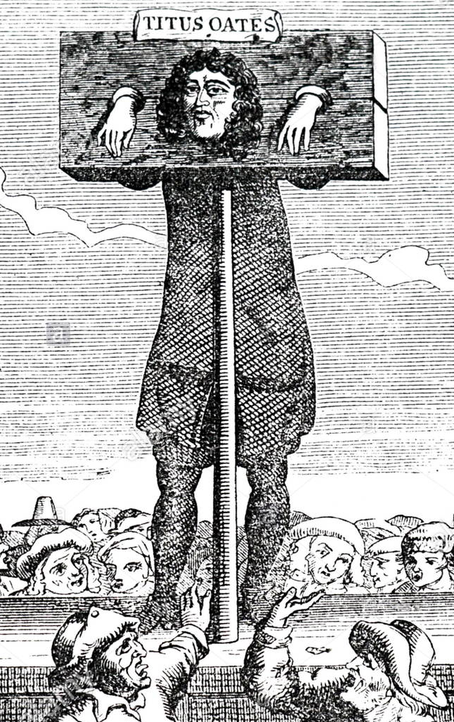
Punishment: Later Middle Ages
Purpose of Punishment: Deterrence
Public humiliation Stocks and pillories – were used to punish lesser crimes e.g. selling weak beer. Whipping
Capital punishment increased. Hanging was seen as a necessary public deterrent to reduce crime.
Continuities
Capital punishment and fines continued
Ways to avoid punishment and specifically the death penalty:
Opt to fight in the army at times of war
Pregnancy protected women
Church courts were lenient especially to clergymen (archbishop, bishops, priests, monks etc) who could claim benefit of the clergy.
Church offered sanctuary and the sheriff could not remove the accused as long as the accused agreed to leave the country.

Slide 18
Did the role of the church help or hinder justice?
Methods used by the church | Help or hinder?
Sanctuary | Hinder – Accused were protected by the church and had 40days to face trial or leave the country. Not even the Sheriff could remove them. This hindered justice as the power was now in the hands of the accused and guilty people could avoid punishment.
Church courts | Hinder – The courts were lenient and never sentenced people to death and clergymen could avoid punishment. Help – dealt with moral offences and controlled peoples everyday lives.
Benefit of the clergy | Hinder – claim by an accused person to be tried in the church courts. Anyone loosely connected to the church could claim benefit of the clergy. The neck verse could be memorised by criminals therefore could avoid punishment.
Trials by ordeal | Hinder – This was based more on luck rather than an accurate judgement of guilt or innocence. The outcome relied on strength which could result in the guilty avoiding punishment and the innocent being punished.

Slide 19
True or false? Q+A
The Statute of labourers prevented labourers from demanding higher wages and stopped them from moving to an area to look for better paid jobs.
Keepers of the Peace or Justice of Peace met 3 times a year to discuss serious crimes.
Coroners investigated crimes using religious ideas.
Benefit of the Clergy involved memorising the “heart verse”
Trials by Ordeals was abolished in 1512.
They met 4 times a year.
Coroners investigated suspicious deaths.
Neck Verse as it would save your neck!
1215! 1215! 1215!

